Slide 1

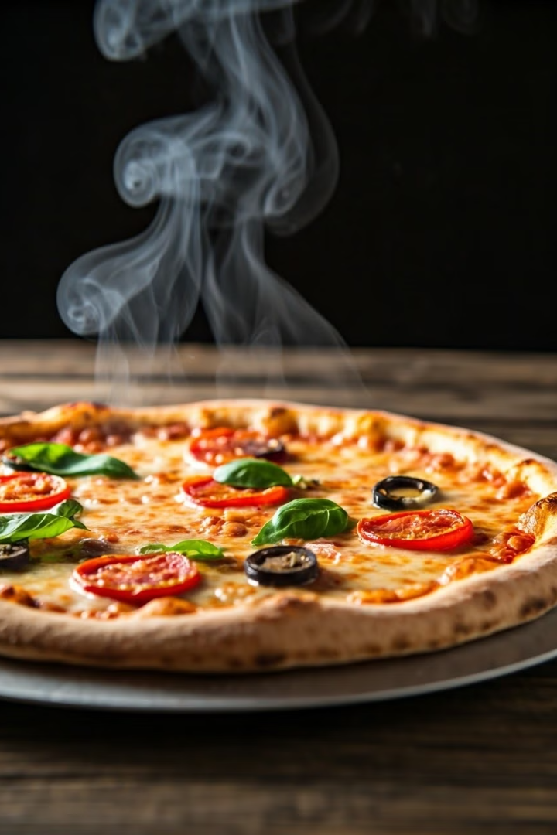
Pizza Sales Analysis
Conducted using SQL Queries
by Tushar Kshirsagar
TK

Slide 2
Introduction
Overview of Analysis
In this presentation, we will explore a comprehensive analysis of our pizza sales data conducted using SQL queries. The primary goal of this analysis is to uncover valuable insights into our sales performance, customer preferences, and ordering patterns.
The analysis focuses on several key metrics:
Total Revenue: Understanding the overall financial performance.
Order Patterns: Examining trends such as average order value, daily and monthly sales variations.
Product Performance: Assessing the popularity of different pizza categories and sizes.
Customer Preferences: Identifying the least popular pizzas to inform future product strategy.

Slide 3


What is the total revenue generated from pizza sales?
Solution:
OUTPUT:

Slide 4

What is the average order value of all orders?
Solution:
OUTPUT:

Slide 5


How many pizzas were sold in total?
Solution:
OUTPUT:

Slide 6


How many distinct order dates are there in the dataset?
Solution:
OUTPUT:

Slide 7
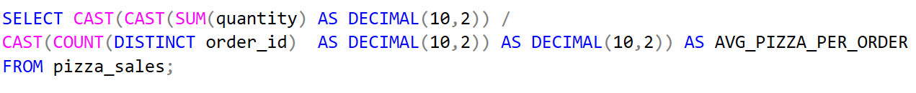

What is the average number of pizzas per order?
Solution:
OUTPUT:

Slide 8
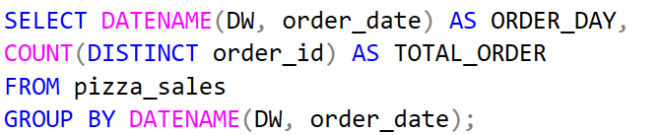
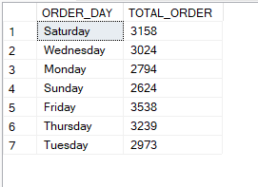
What is the total number of orders for each day of the week?
Solution:
OUTPUT:

Slide 9
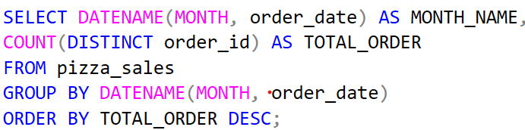
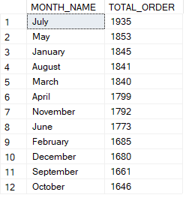
Which month had the highest number of orders?
Solution:
OUTPUT:

Slide 10
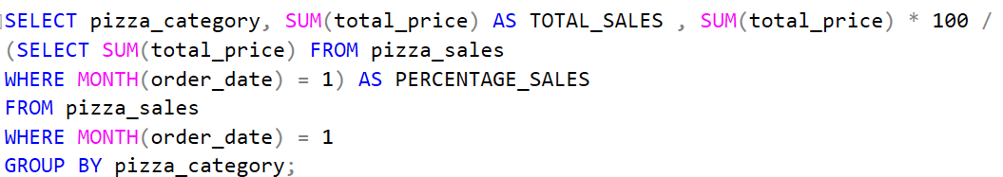
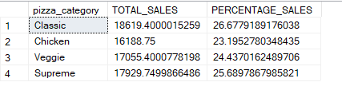
For January, what were the total sales and percentage of
sales for each pizza category?
Solution:
OUTPUT:

Slide 11
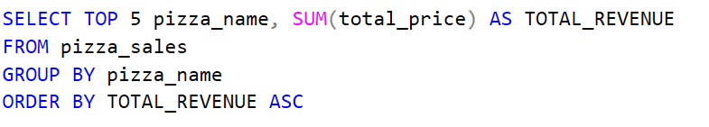
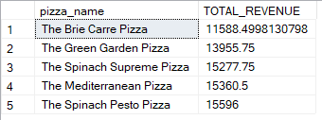
What are the top 5 least popular pizza names based on
total revenue?
Solution:
OUTPUT:

Slide 12
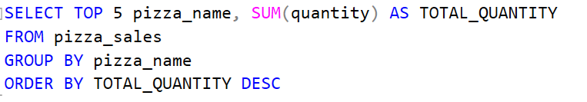
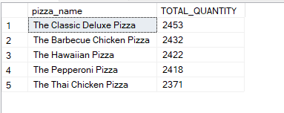
What are the top 5 most popular pizza names based on
total quantity sold?
Solution:
OUTPUT:

Slide 13
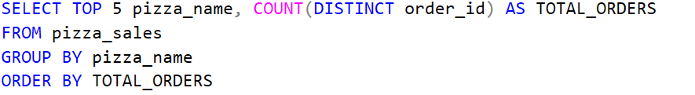
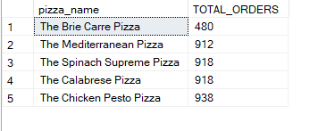
What are the top 5 most popular pizza names based
on the number of distinct orders?
Solution:
OUTPUT:

Slide 14

Insights and Recommendations
Revenue and Sales Trends:
Product Performance:
Customer Ordering Patterns:
Insight : Popular pizza categories and sizes drive most of the revenue, while some items underperform.
Recommendation : Focus on promoting best-sellers and consider revising or discontinuing less popular items to streamline the menu.
Insight : Average order values and daily sales patterns are stable, with notable fluctuations on peak days.
Recommendation : Optimize staffing and inventory management based on these patterns to improve operational efficiency and customer satisfaction.
Insight : Peak sales are observed on specific days and during certain months.
Recommendation: Target marketing campaigns and promotions around these high-demand periods to boost revenue.

Slide 15

Conclusion
In summary, this analysis provides a detailed overview of our pizza sales, highlighting key trends in revenue, product performance, and customer behavior. By leveraging these insights, we can make informed decisions to optimize our menu, enhance marketing strategies, and improve operational efficiency. These data-driven recommendations will not only help in maintaining strong sales performance but also in driving future growth and customer satisfaction.

Slide 16
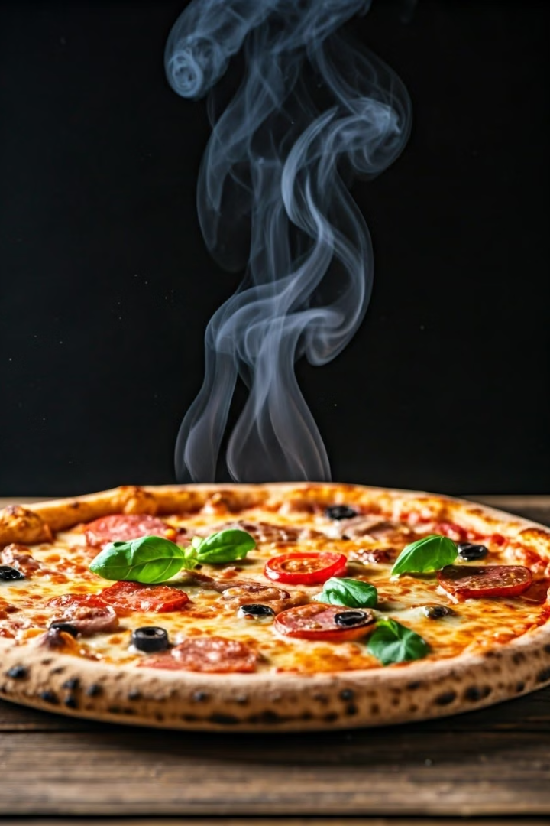
Thank you

